Slide 2
Brian Robeson is the main character of Hatchet. He is a 13 year old boy traveling by plane to visit his father in the oil fields in Canada. Before Brian aboard the Cessna 406, his mother gives him a hatchet. Brian is raised in the city and he doesn’t realize that this one gift, just might make the difference between life and death.

Slide 3
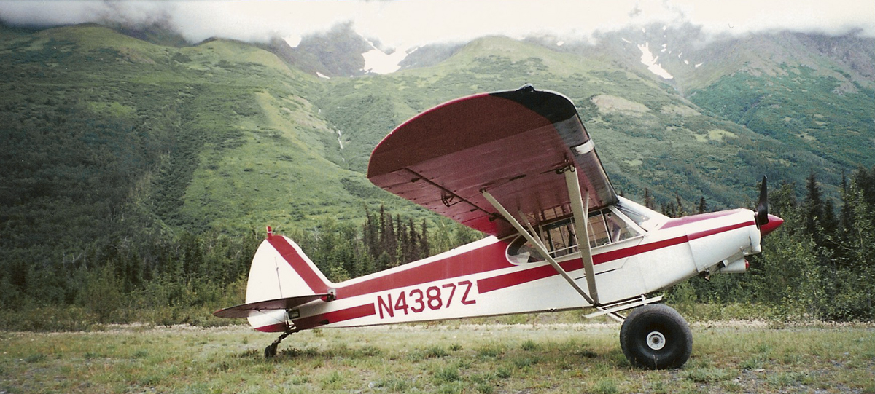
Notes:
What does his mother give him? Where is going? How is he going to get there?

Slide 4
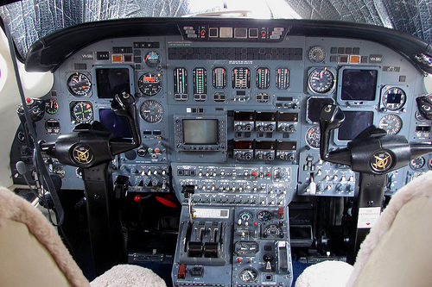
Complications
Complications arises when the Pilot’s mouth went rigid, holding his shoulder and hissed, “Chest! My Chest is coming apart!” This implies that the pilot is having a heart attack and dies shortly after. Leaving Brian full control of the plane.

Slide 5
Complications
Complications further arises as now the Cessna is out of gas and Brian crashes the plane into the lake.
Notes:
“L” Shape lake

Slide 6
Brian survives the plane crash and now must learn how to survive in the wilderness with nothing but his hatchet.
Sub Plot
Brian has been thinking about his parent’s recent divorce. More specifically, Brian know about his mother’s secret. “The Affair.”

Slide 7
Notes:
Have you ever been out in the wilderness? What are few items did you have with you?

Slide 8
More Complications
Man vs. Nature
Besides worrying about finding shelter, food, and water, Brian understands that his needs
fire!

Slide 9
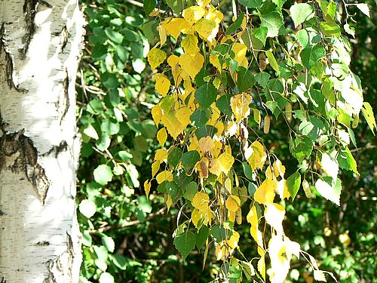
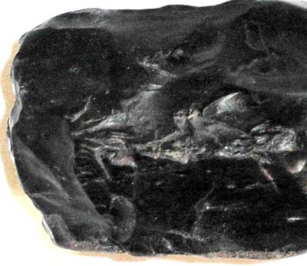
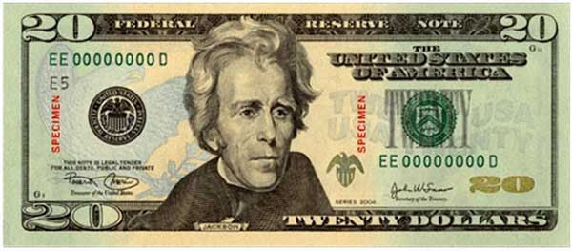
Notes:
What does Brian use to make fire?- Black rock (flint), Hatchet, Birch, and his twenty dollar bill. What is missing? –A steady stream of air.

Slide 10
Notes:
With the Survival Kit at hand, how do you think Brian feels about his surroundings? -Home

